Slide 1
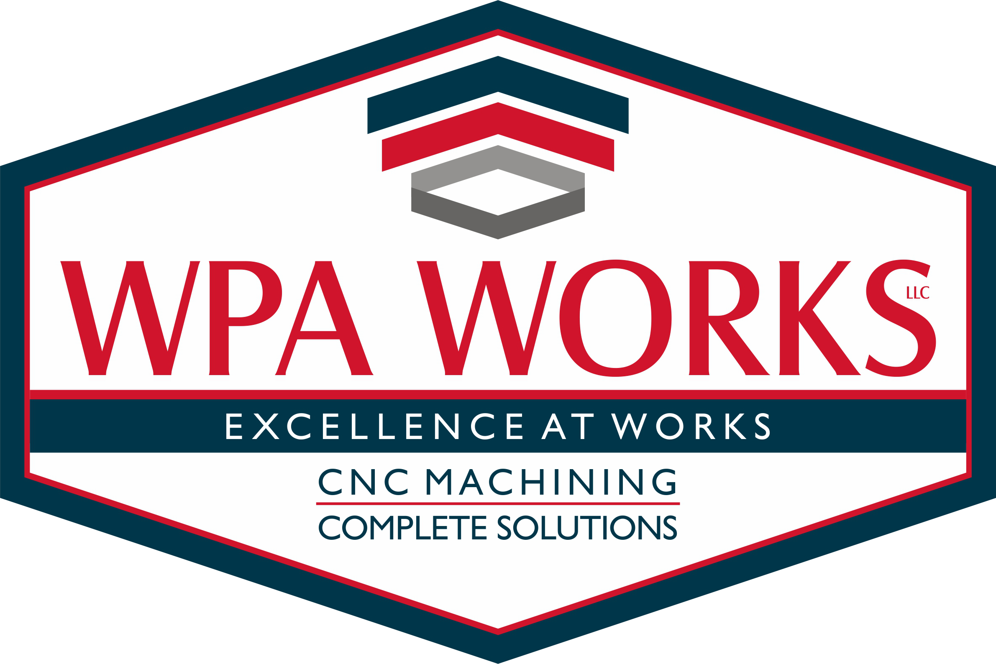

Slide 2

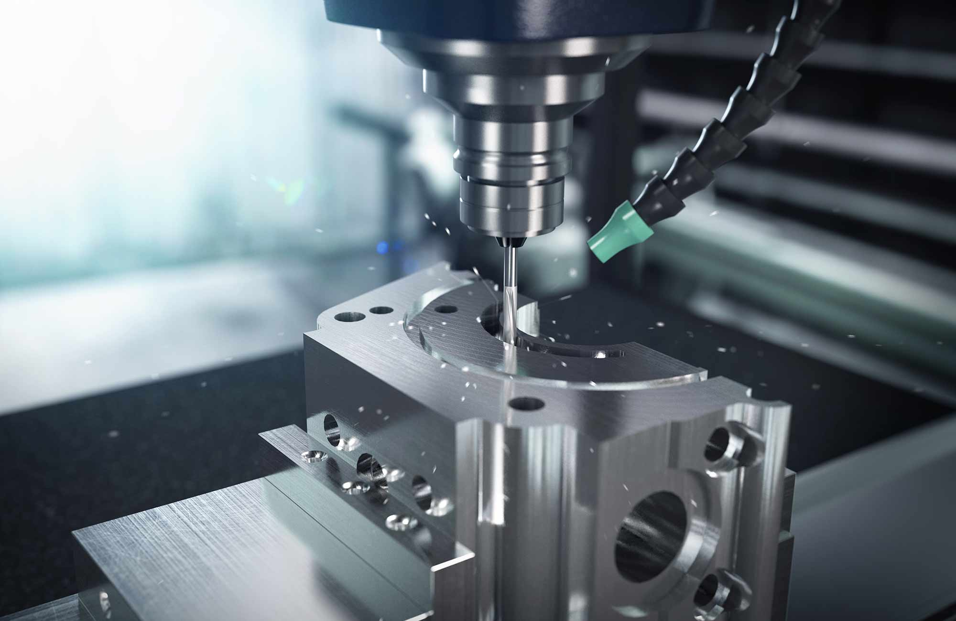
Who is WPA
A young dynamic CNC manufacturing company that provide its customers innovative solutions for their requirements, creates unlimited opportunities for its employees, and is a model entity in our community.
MISSION STATEMENT
The mission of WPA Works LLC is to supply products and services that will exceed customer expectations.

Slide 3


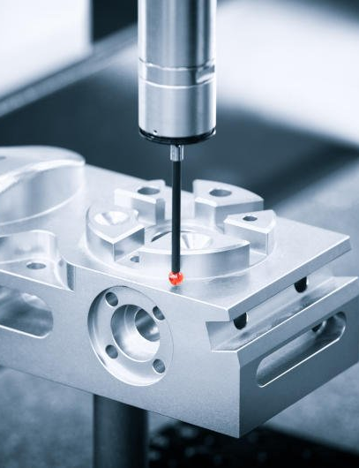
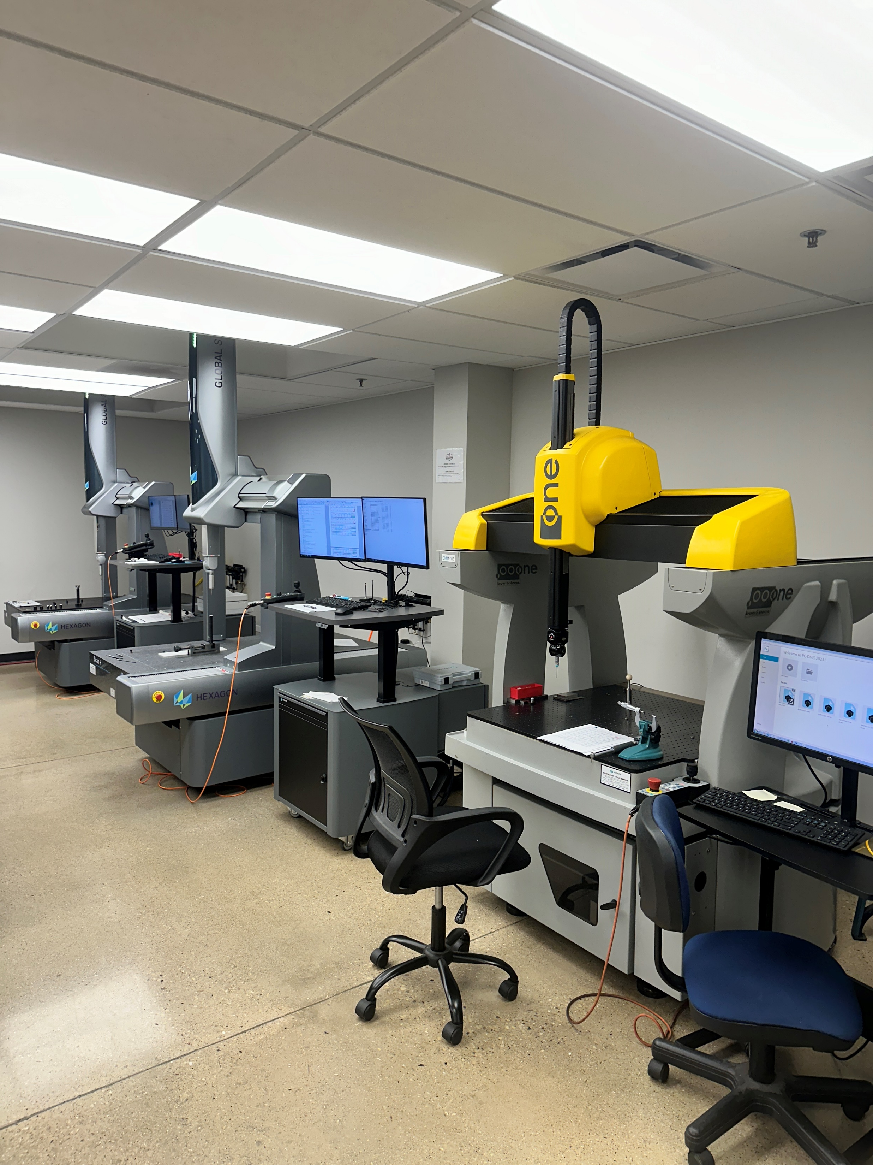
Quality Policy
Exceed
Exceed Customer Expectations
Improve
Continuously Improve our Quality Management System
Enhance
Enhance Customer Satisfaction

Slide 4
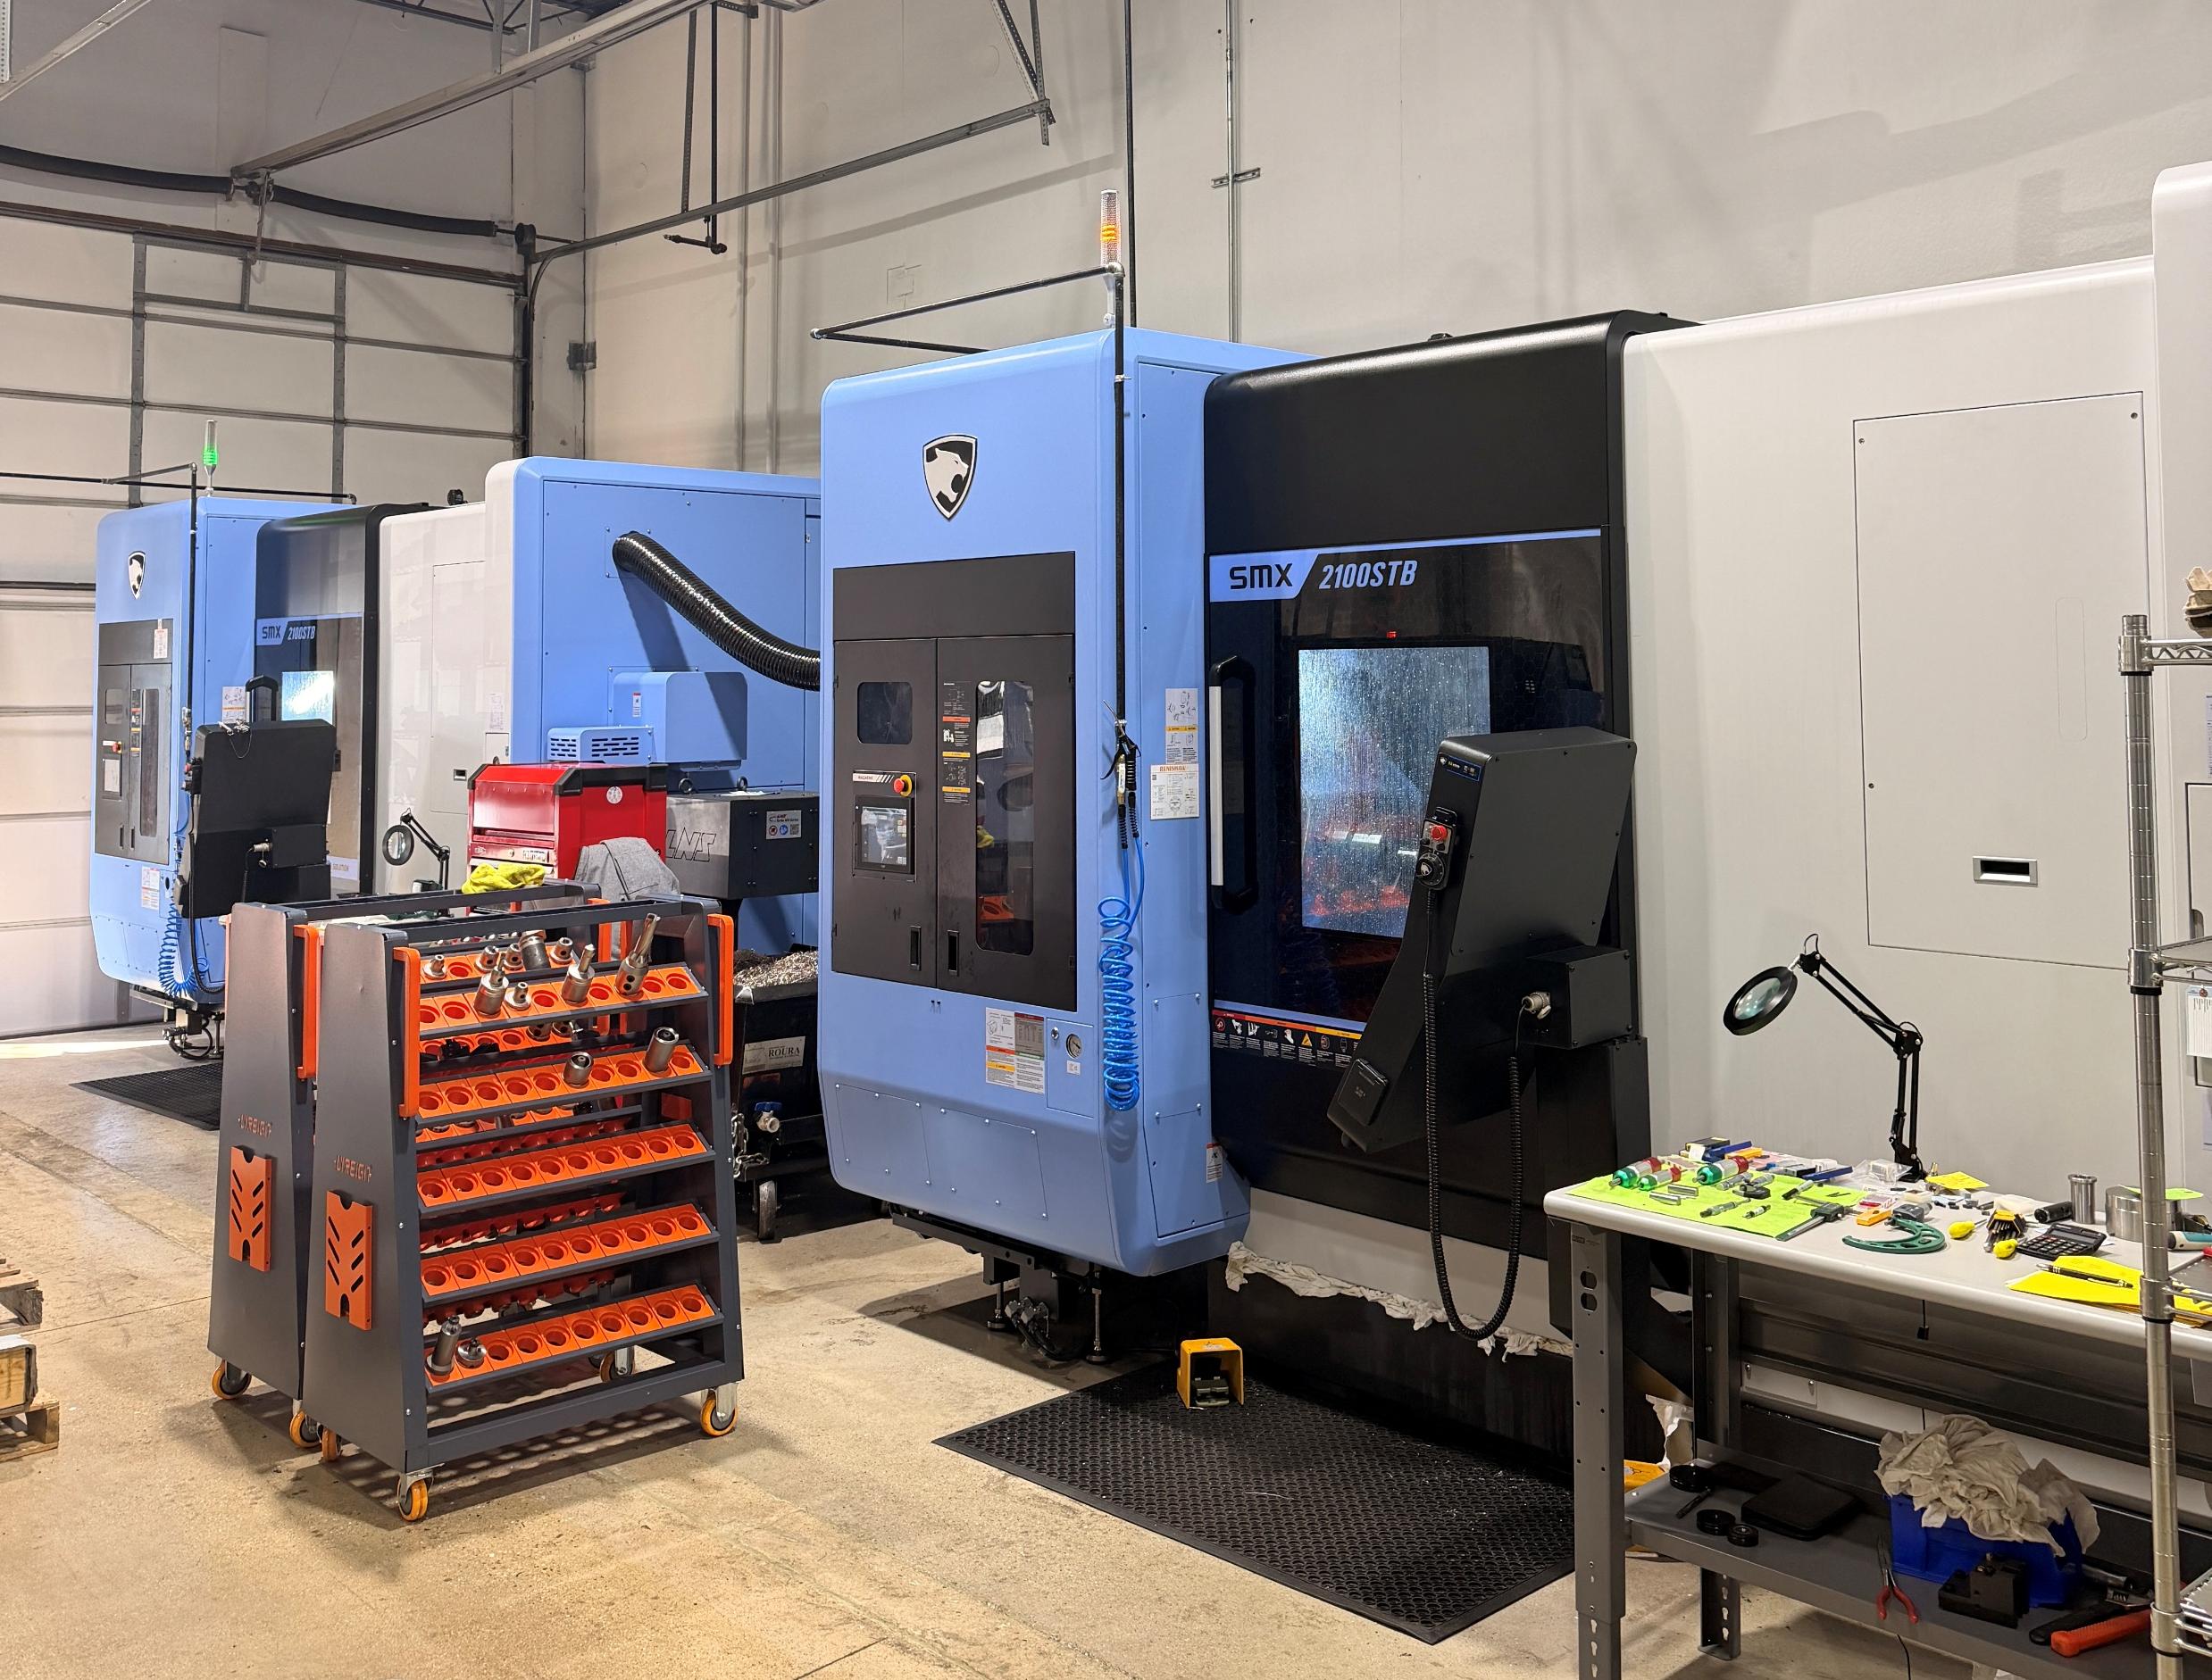
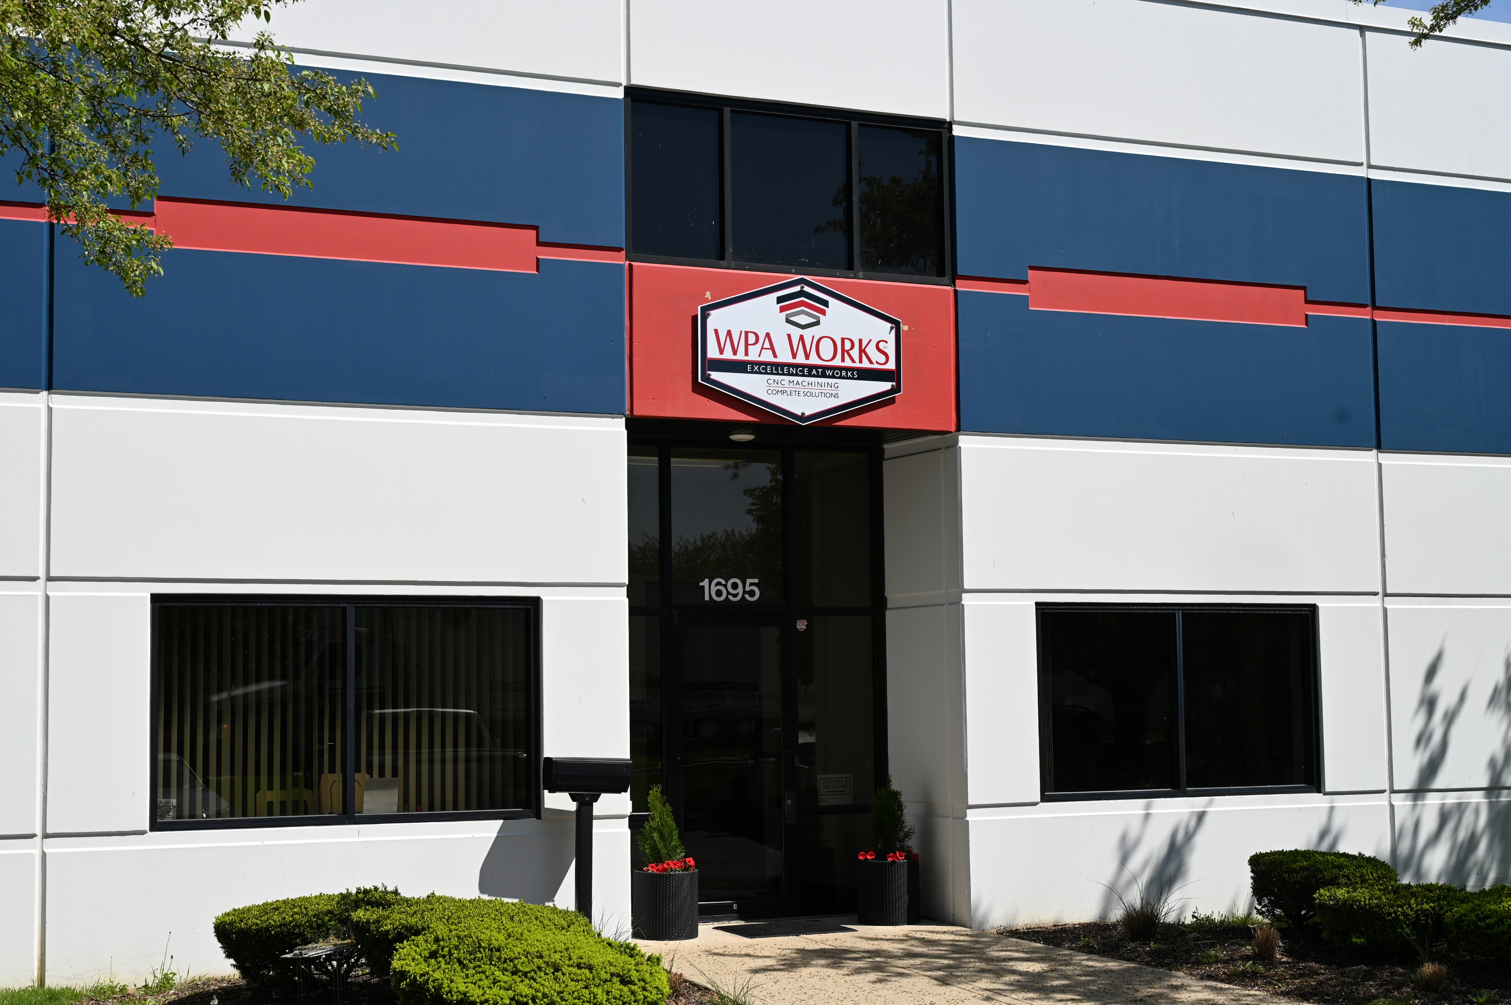
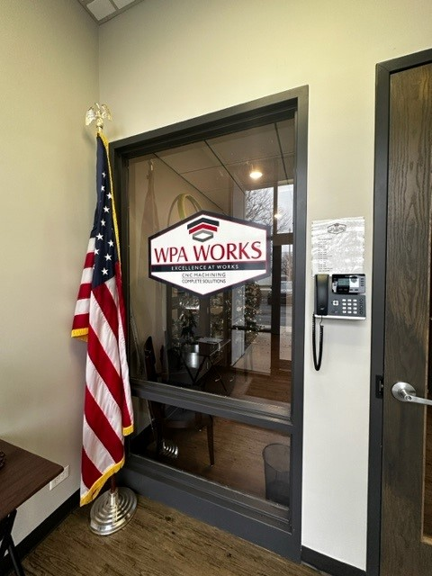
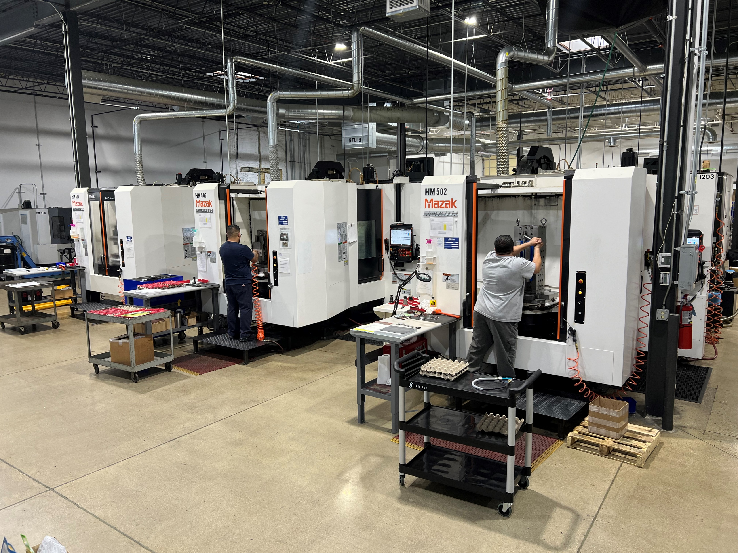
Company Profile
Certifications: - AS9100 Revision D
- ISO9001:2015
Strong footprint in quick turn Aerospace, Defense, Energy, and Medical manufacturing. WPA Works LLC manufactures and develops high-precision machined components and manages complex assemblies. Our turnkey solutions offer simplified logistics, reduced costs, shortened lead times, and superior quality products.
Current Employees: 60

Slide 5
History of WPA
2018
WPA Founded
By the Barszczuk
family
December of 2018
2019
WPA expands and adds assembly in 2nd Facility
2020
WPA expands and adds 3rd facility
2021
Joined Fermilab Protégé
AS 9100, ISO certification
2022
WPA Acquires state of the art modern Facility
2023
WPA Acquires over half a dozen machines to triple capacity
2024
WPA Acquires 3 new machines, 2 CMM’s, a passivation line, and a tool vending machine
Positioned for further Growth
WPA acquires 2 new Mill-turns
5 new lathes
and 2 new CMM’s
2025
2026
WPA Acquires 2 new lathes and 3 new 5-Axis

Slide 6
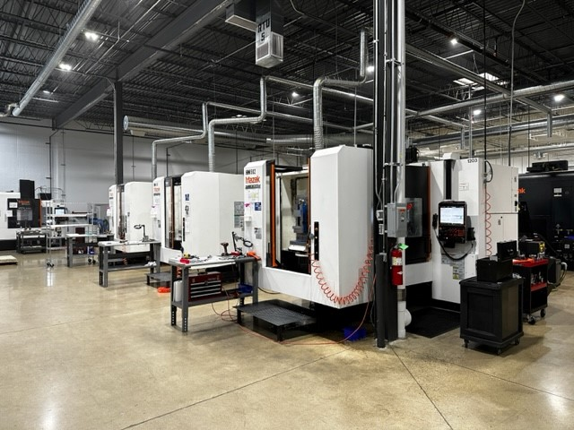
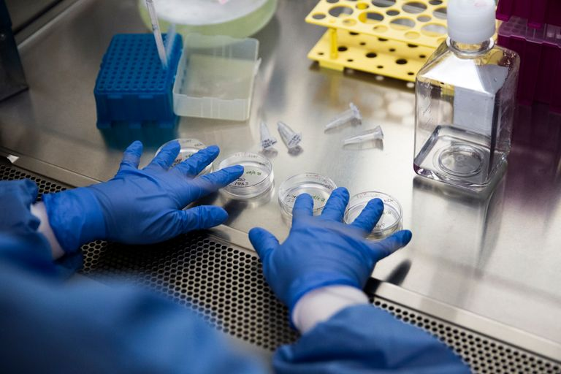
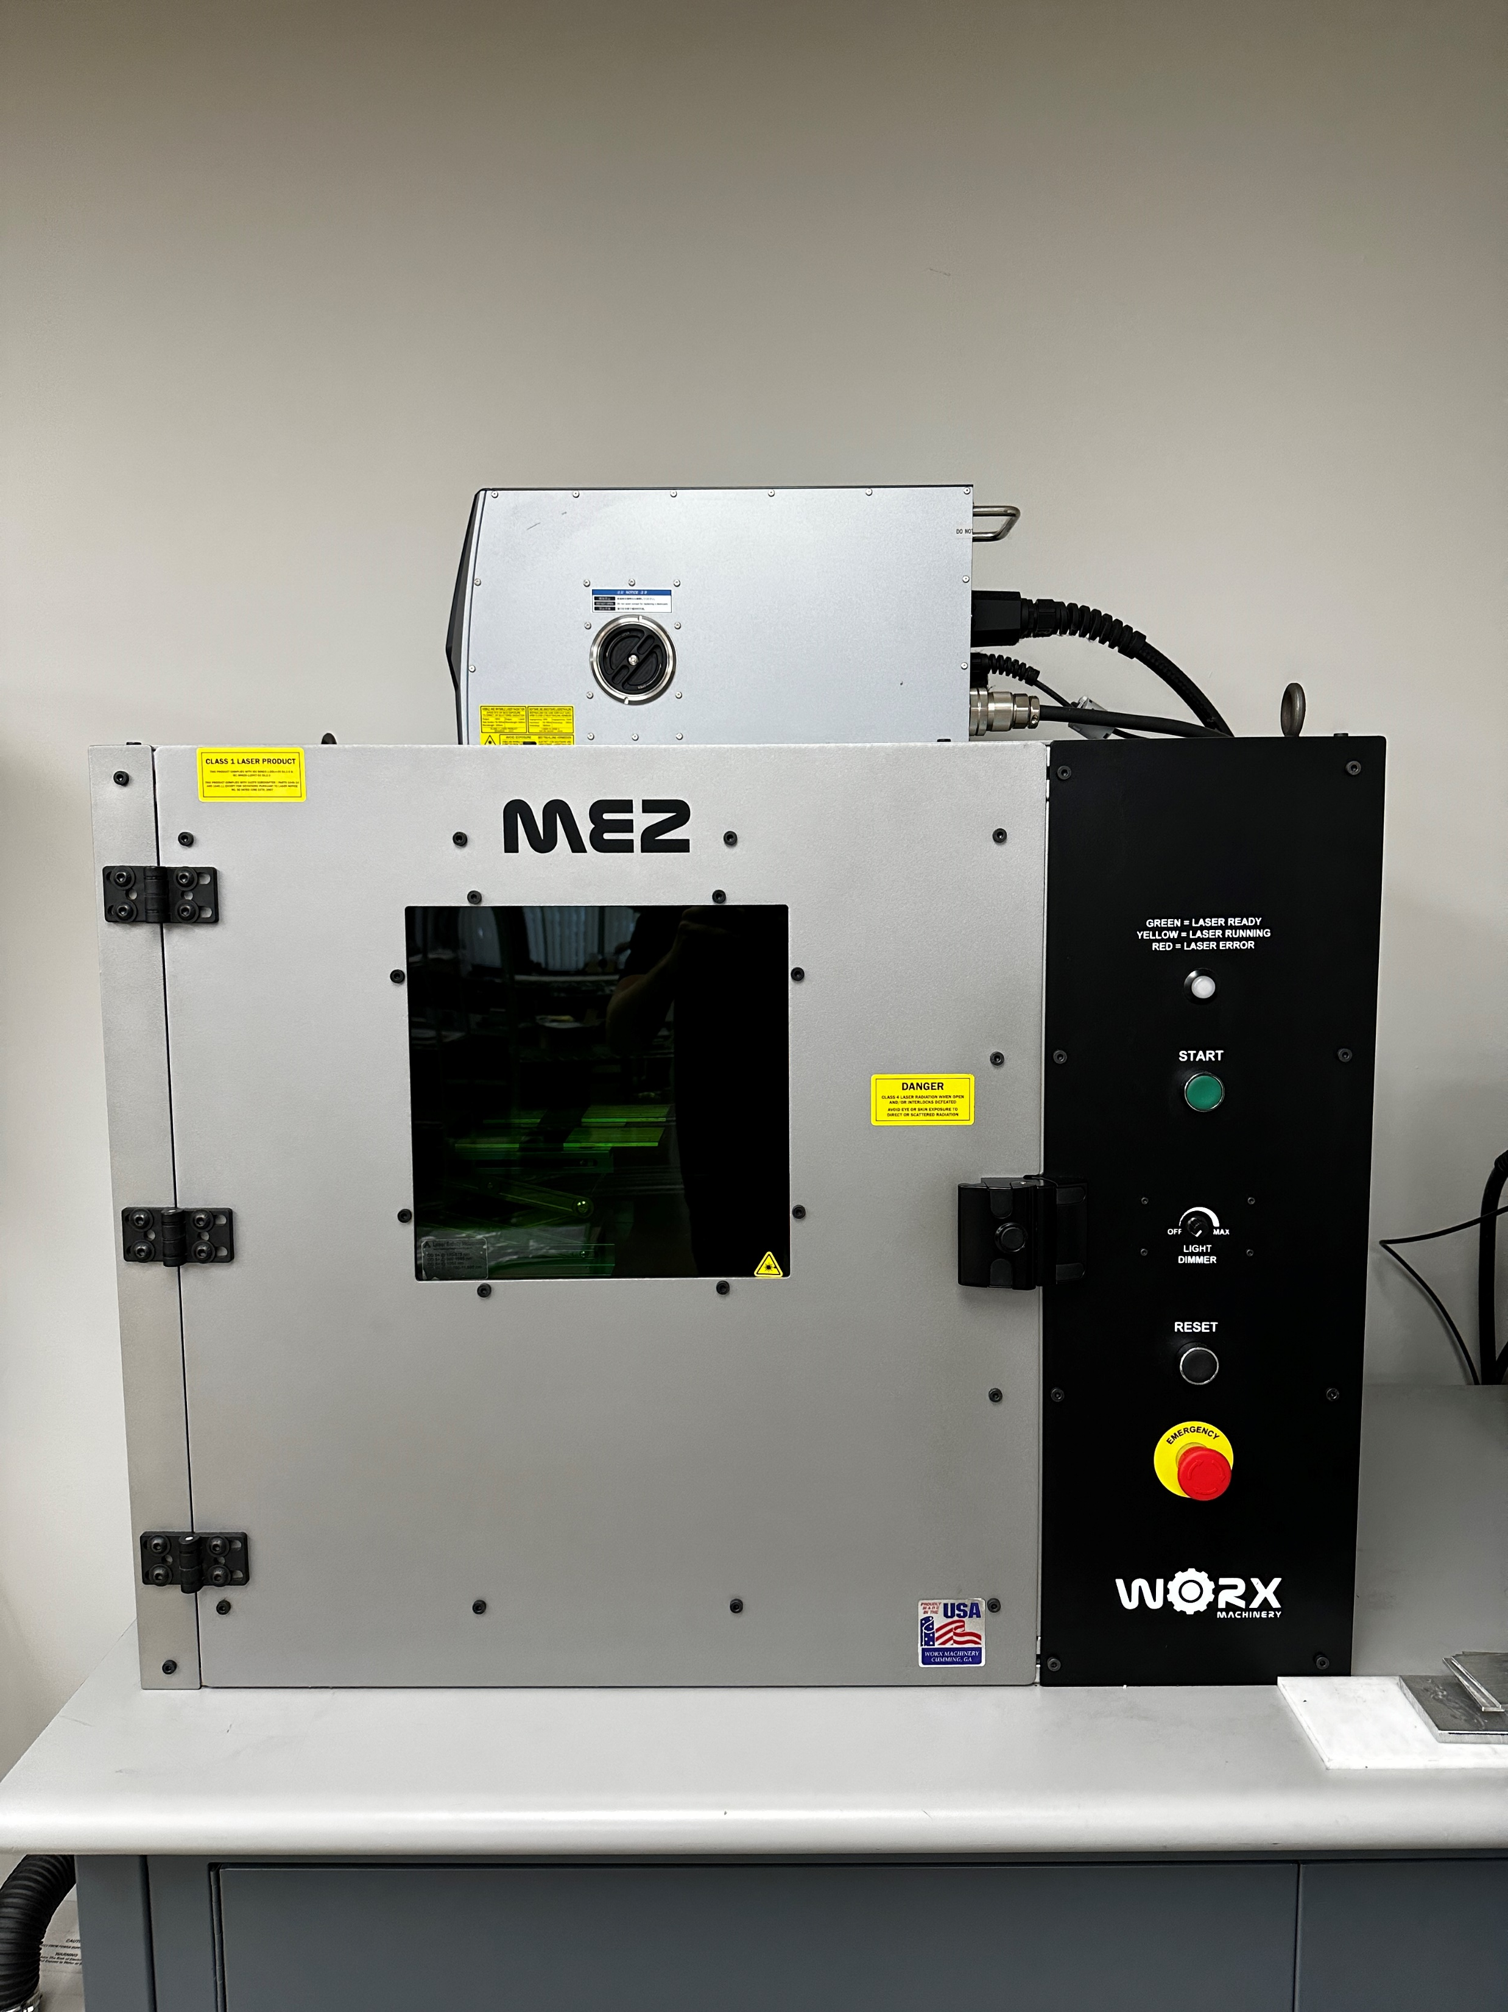
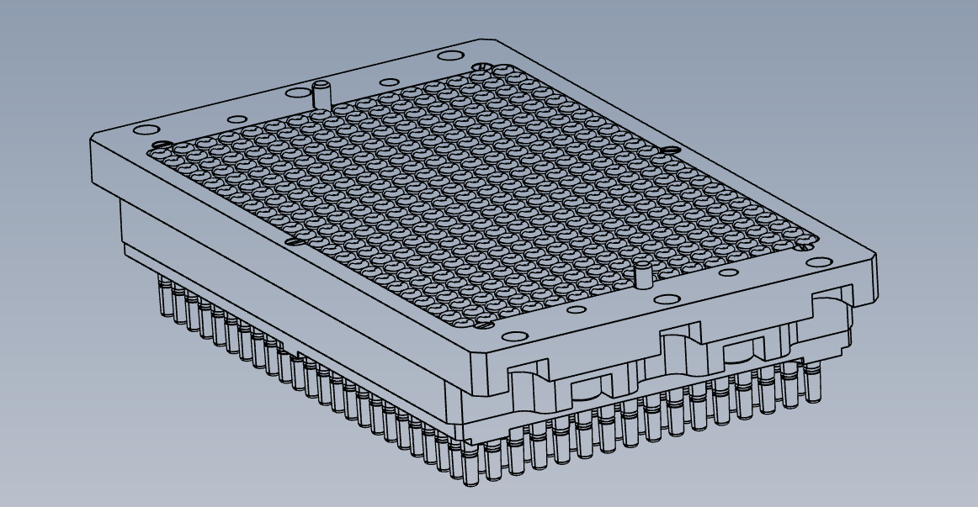
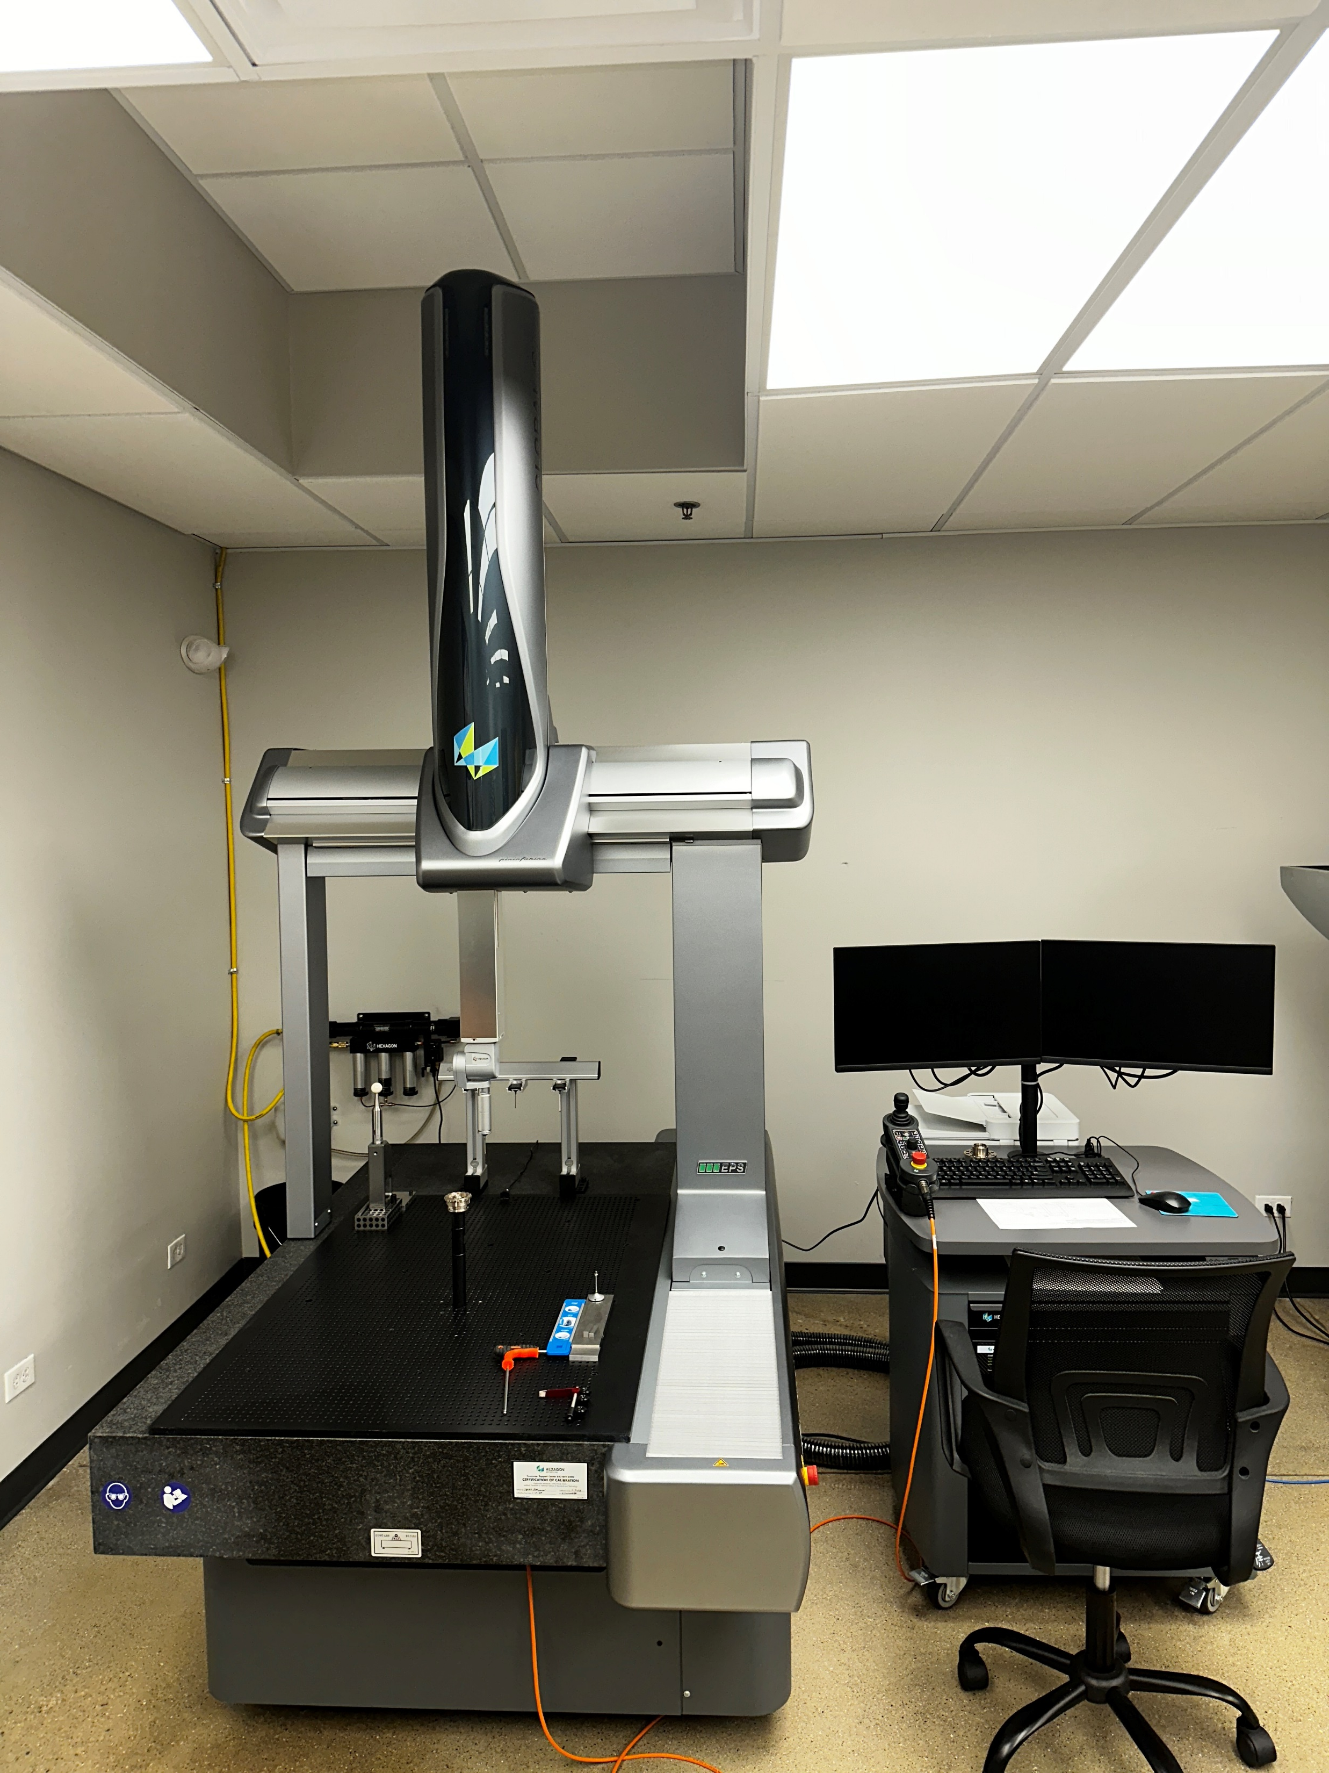
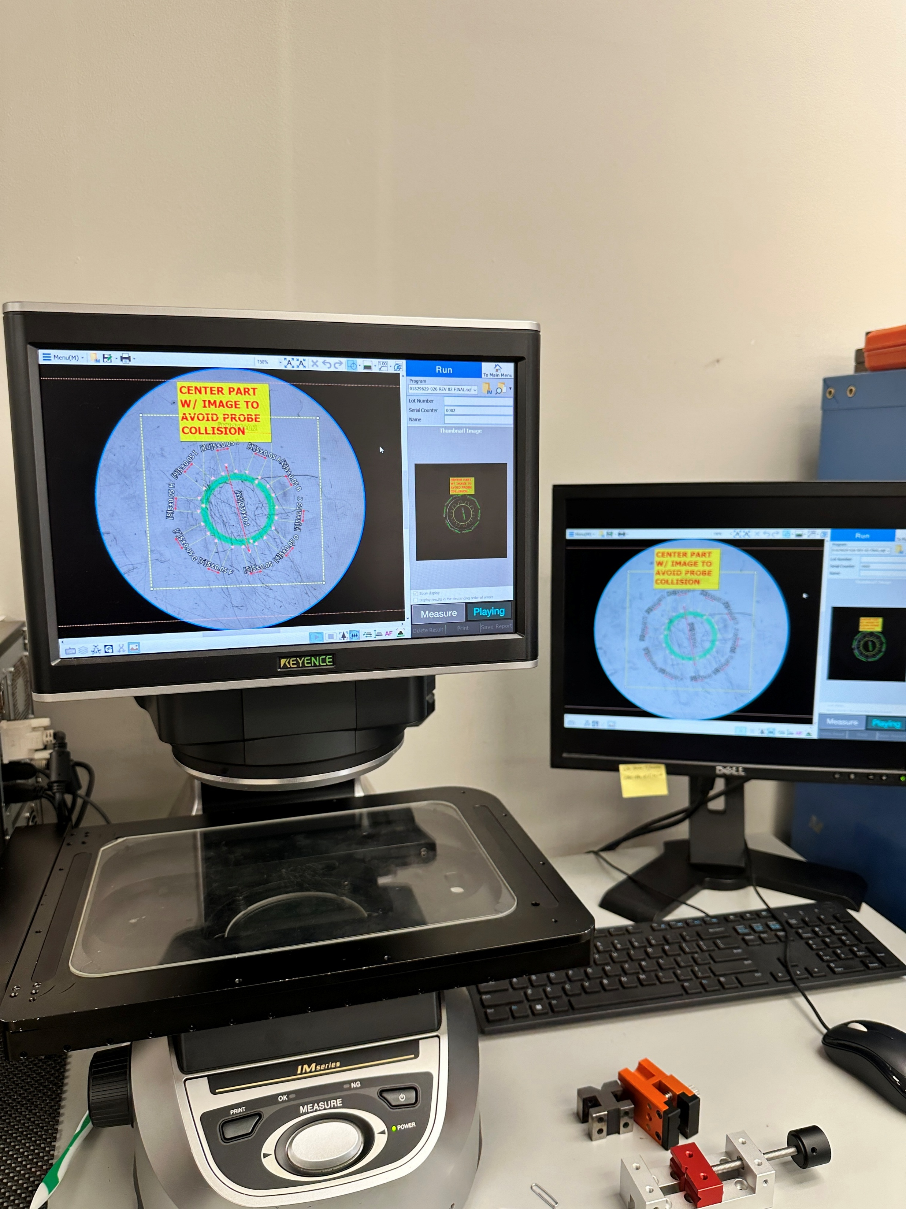
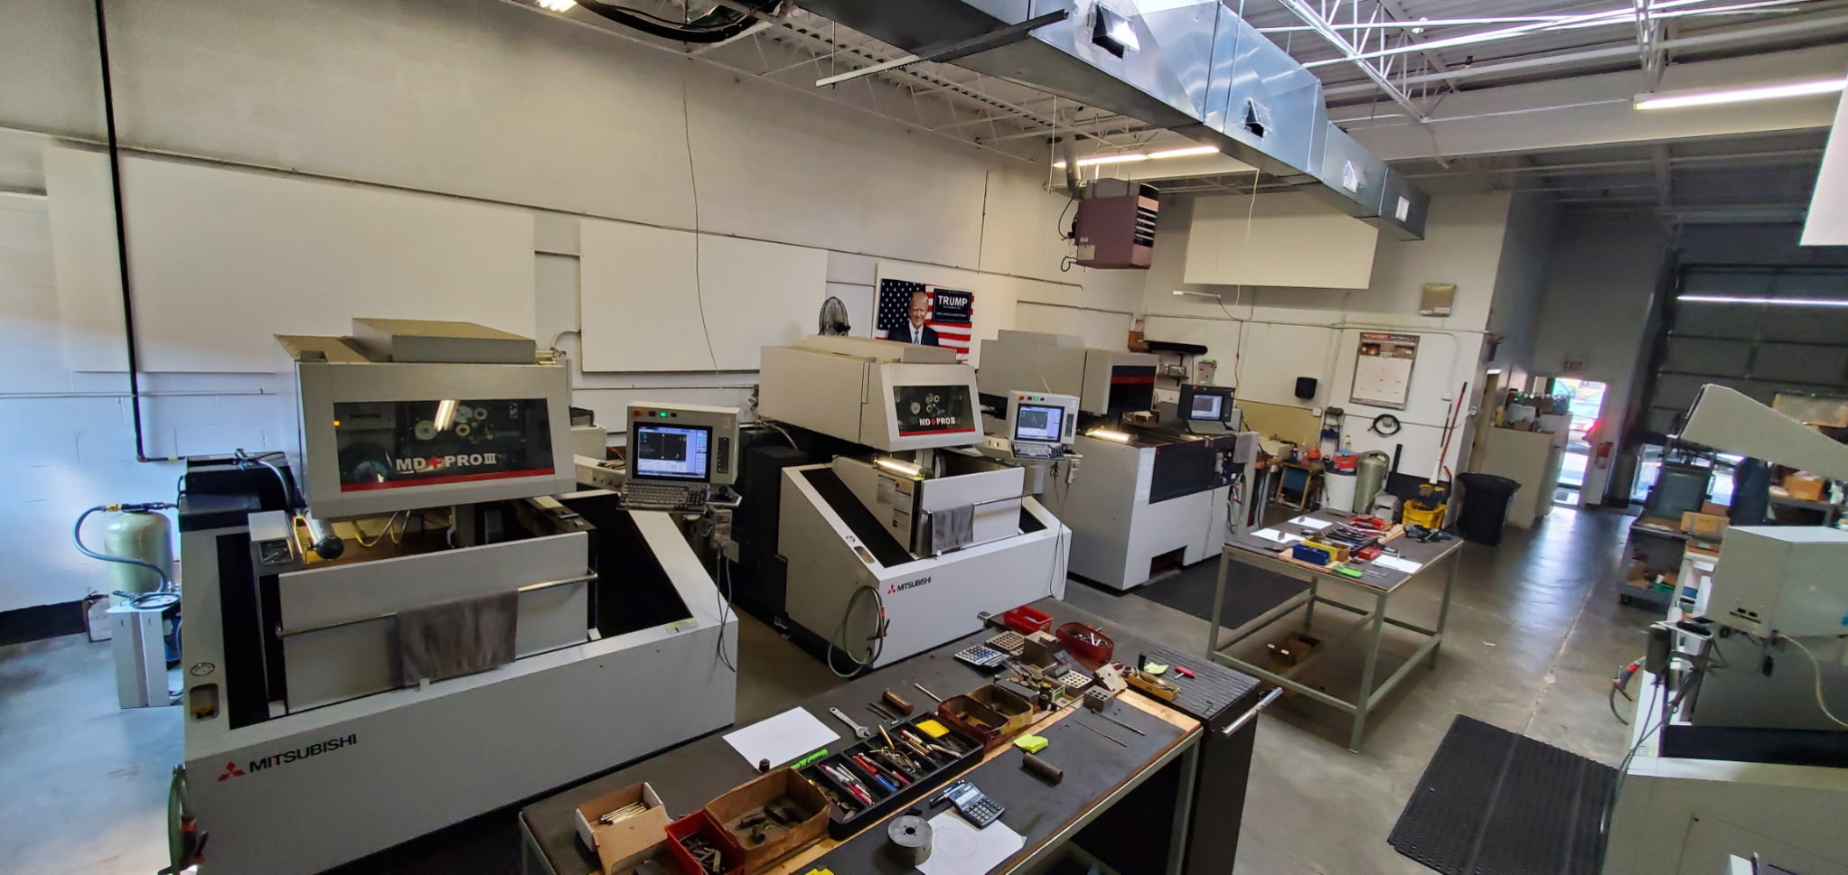
Capabilities
Machining
Assembly
Quality Control
Laser Etching
- Milling via 5-axis, 4-axis, 3-axis
- Complex Turning (Lathe)
- Wire EDM
- Complex Assembly capability
- Weldment assemblies
- 4 CMM machines
- Keyence Vision System
- Yearly/ semi-annually calibrated measuring tools
- Quality standards upheld and audited on a yearly basis to uphold AS9100 and ISO certifications
- State of the art technology for branding parts (QR Codes, part number traceability, company branding, etc.)

Slide 7
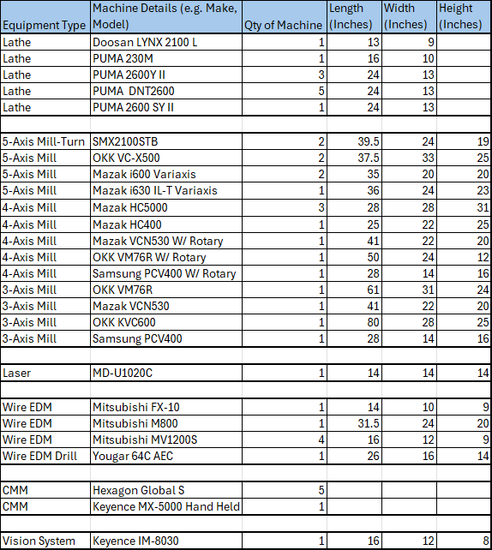
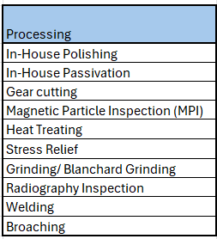
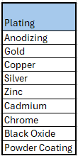
Tool List/ Processing Capabilities

Slide 8
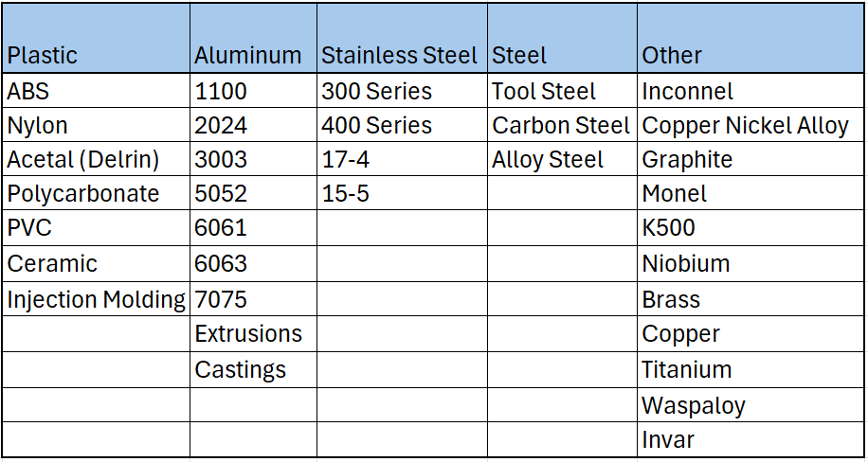
Material Capabilities

Slide 9
Industries Served

Slide 10
Why Partner with WPA
Reliability
- Quality
- On time delivery
- Established Process (AS9100)
- Quick quotes
Responsive and Accessible
- Open door policy
- Short lead times
- We are open minded and willing to tailor to customer expectations
Community
- Contributing to local community/ economy
- Continuous education and development of employees
- Employee Retention
Competitive
- Pricing, due to our state of the art equipment
- Lead times
- Superior quality and attention to product details

Slide 11
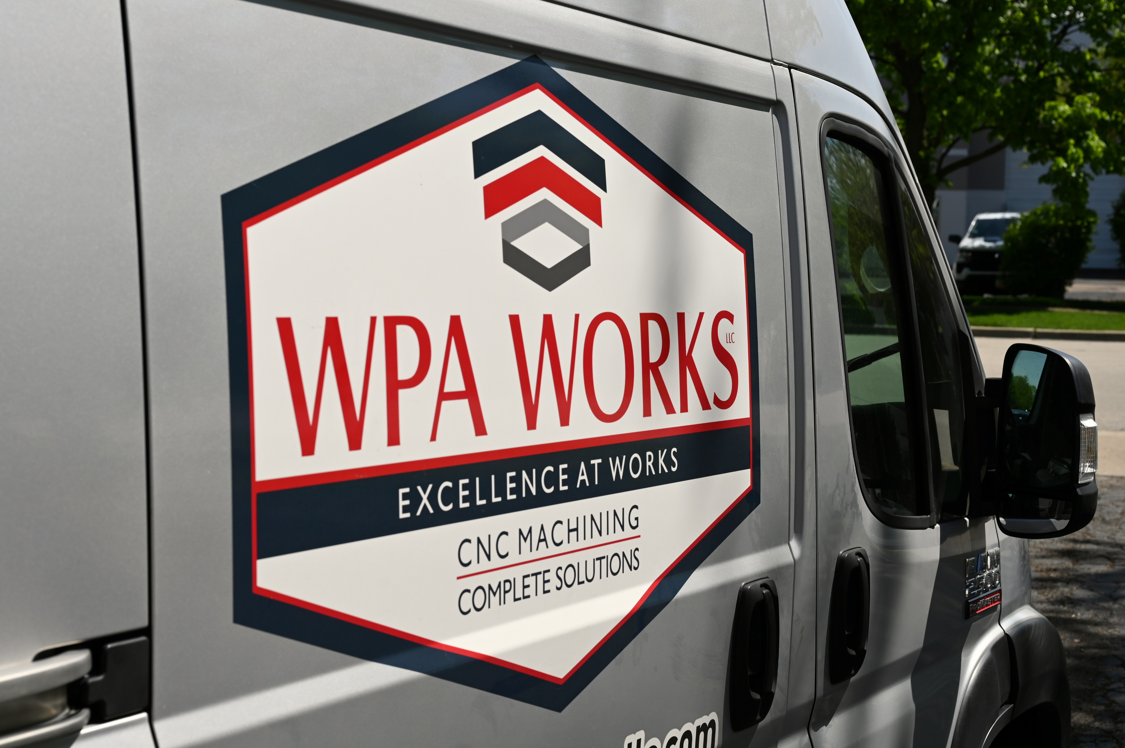
Questions?
For more information on how WPA Works LLC can become a strategic partner in your supply chain, please contact us below.
FOR INQUIRIES:
1695 Cambridge Drive, Elgin, IL 60123
www.WPAWorksLLC.com
630.557.9995
Business Development
CEO
Business Development
Owner
Patryk@wpaworksllc.com
Peter@wpaworksllc.com
AL@wpaworksllc.com
Iwona@wpaworksllc.com

Slide 12
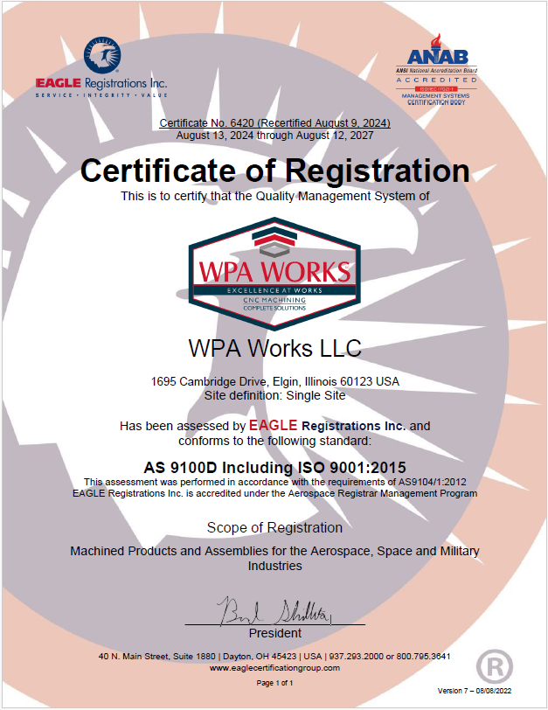
AS9100D ISO 9001:2015

Slide 13
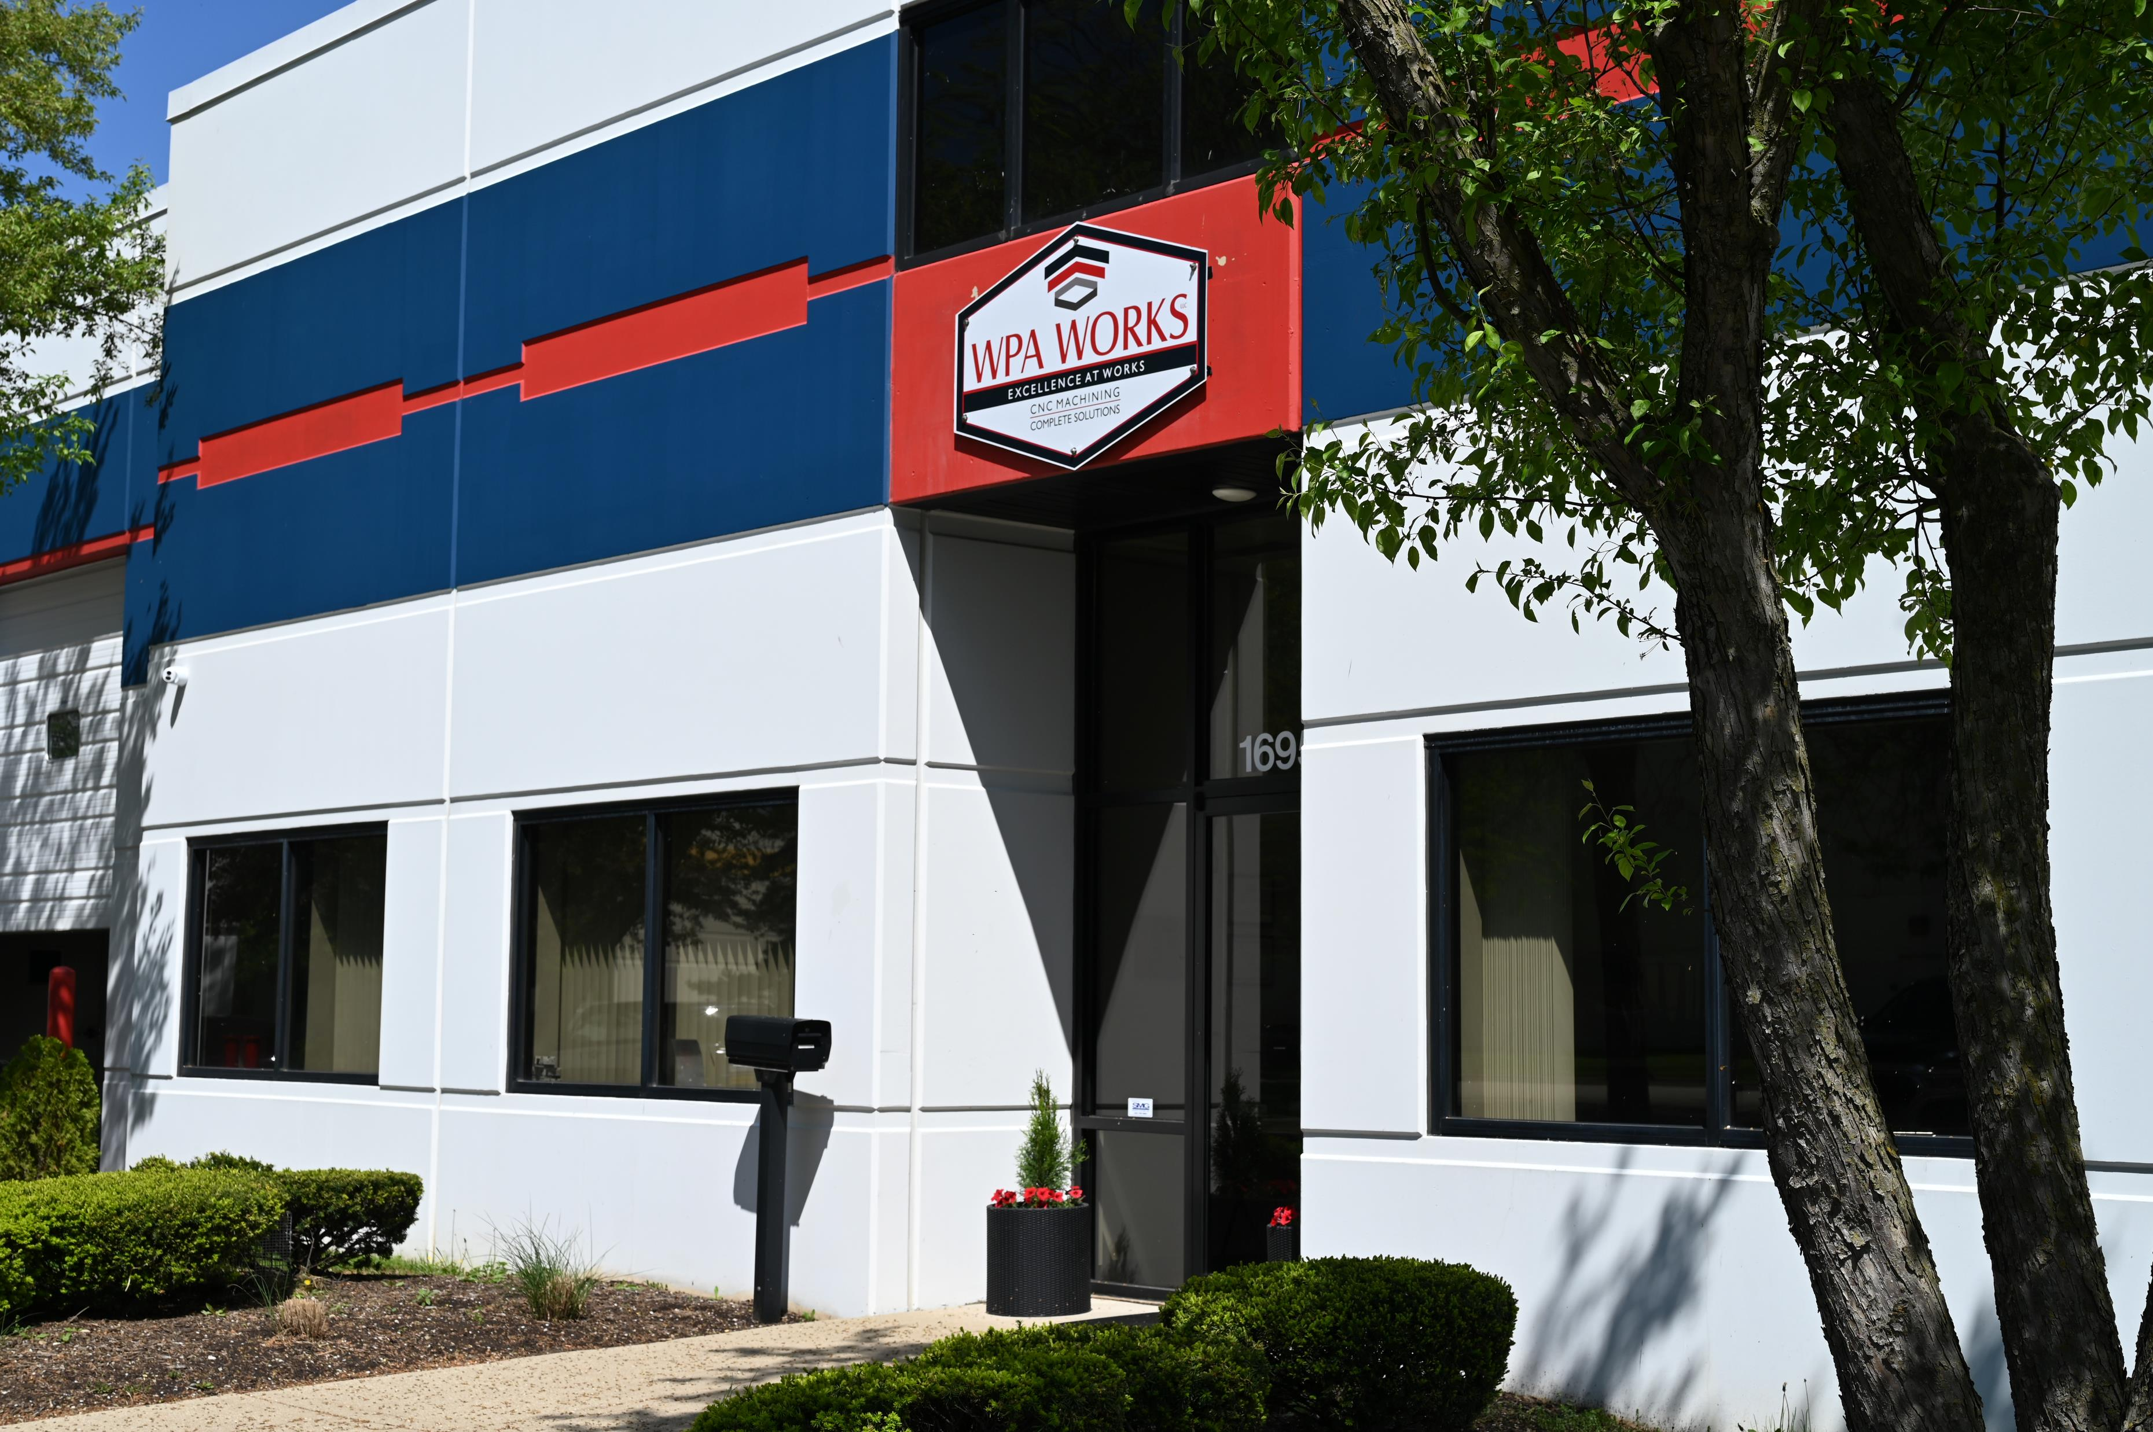

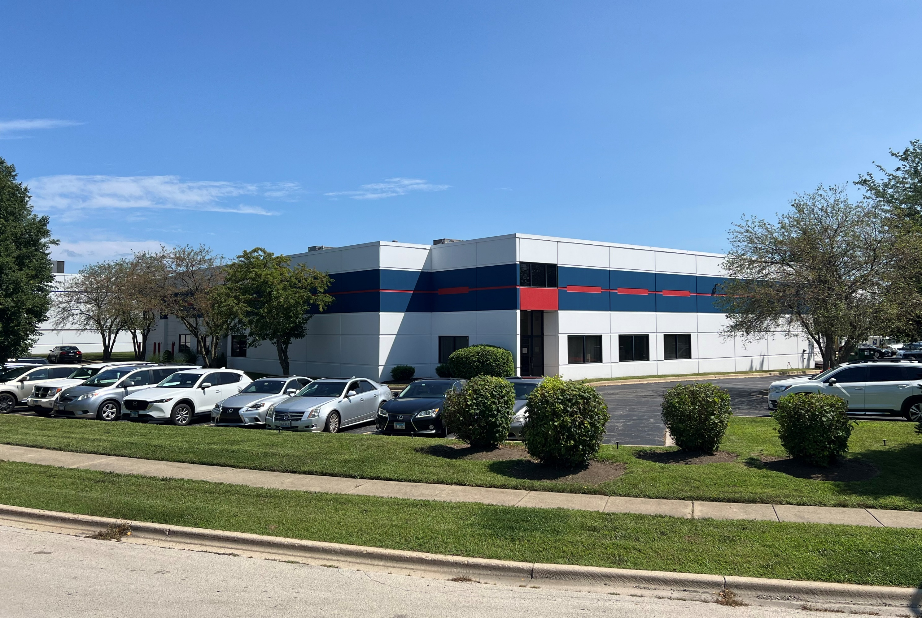
1695 Cambridge Dr.
Elgin IL, 60123

